Slide 1
Modeling and Control of a Redundant Robotic Arm
Turki Haj Mohamad
5/10/2018

Slide 2
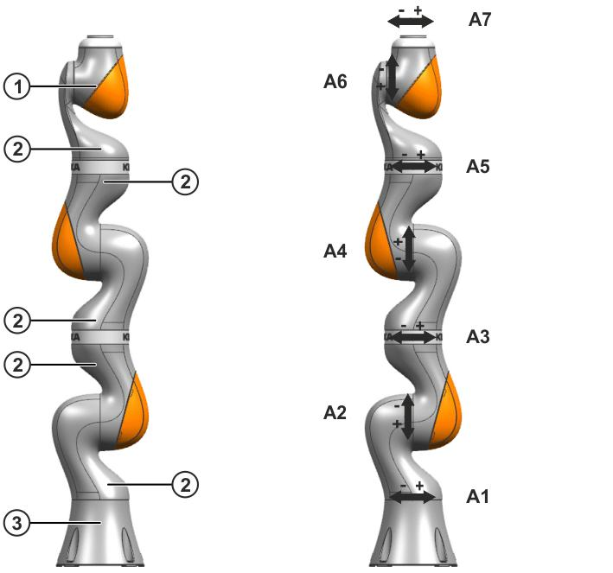
Robot Description
(a)
(b)
iiwa 7 R800 (KUKA Laboratories)
Redundant robot consists of 7 rotational joints (7 dof)
 | LBR iiwa 7 R800
Number of axes | 7
Number of controlled axes | 7
Volume of working envelope | 1.7 m³
Weight | 23.9 kg
Maximum reach | 800 mm
Mounting position | Floor, Ceiling, Wall
(a) LBR iiwa 7 R800 assemblies. (b) LBR iiwa 7 R800 7 axes.

Slide 3
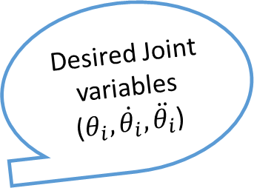
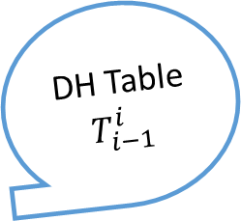
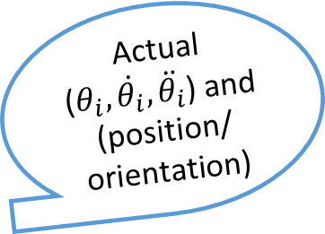
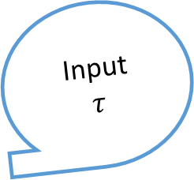

EOM
$$M,c,φ$$
DH Table
$$T_{i−1}^{i}$$
Dynamical Modeling
Kinematic
Actual
($θ_{i}, \dot{θ_{i}}, \ddot{θ_{i}}$) and (position/
orientation)
Desired Joint variables ($θ_{i}, \dot{θ_{i}}, \ddot{θ_{i}}$)
Inverse Kinematic
Actual Response
Desired path
(position and orientation)
Input
$$τ$$
Trajectory Planning
Sliding Control

Slide 4

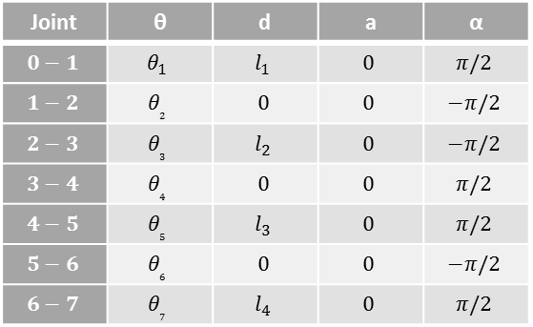
Forward Kinematic
Z₇
Z₆
X₇
θ₇
$$l_{4}$$
Z₅
θ₆
Joint | θ | d | a | α
$$0−1$$ | $$θ_{1}$$ | $$l_{1}$$ | $$0$$ | $$π/2$$
$$1−2$$ | $$θ_{2}$$ | $$0$$ | $$0$$ | $$−π/2$$
$$2−3$$ | $$θ_{3}$$ | $$l_{2}$$ | $$0$$ | $$−π/2$$
$$3−4$$ | $$θ_{4}$$ | $$0$$ | $$0$$ | $$π/2$$
$$4−5$$ | $$θ_{5}$$ | $$l_{3}$$ | $$0$$ | $$π/2$$
$$5−6$$ | $$θ_{6}$$ | $$0$$ | $$0$$ | $$−π/2$$
$$6−7$$ | $$θ_{7}$$ | $$l_{4}$$ | $$0$$ | $$π/2$$
X₅, X₆
Z₄
θ₅
$$l_{3}$$
$$T_{i−1 }^{i}$$
θ₄
Z₃
X₃, X₄
Z₂
θ₃
$$l_{2}$$
Z₁
θ₂
X₁, X₂
Z₀
$$l_{1}$$
θ₁
X₀

Slide 5
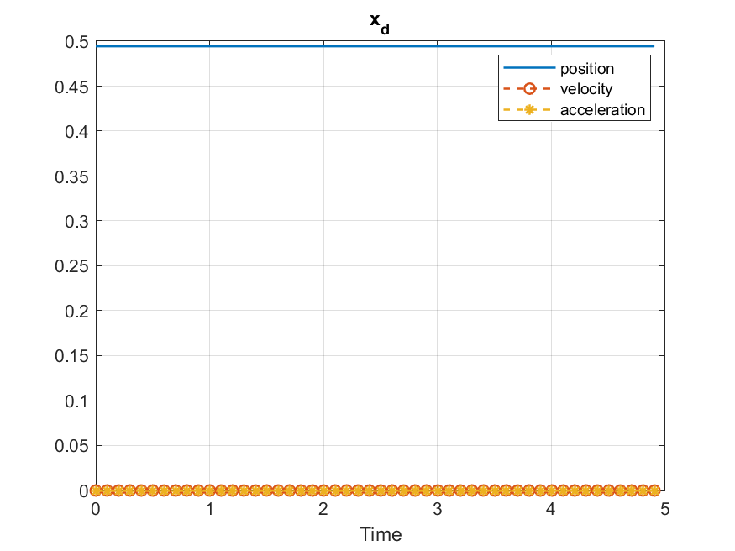
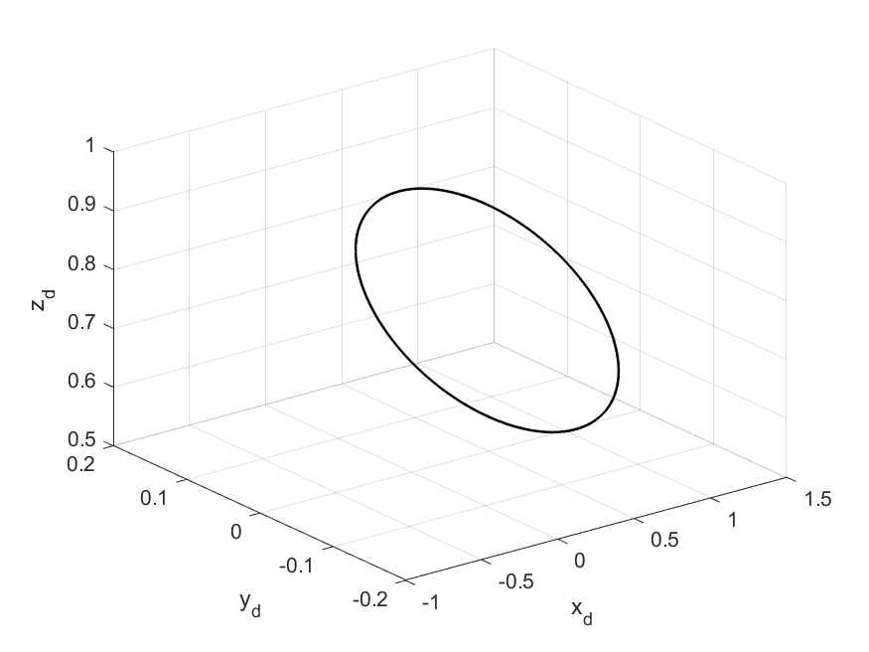
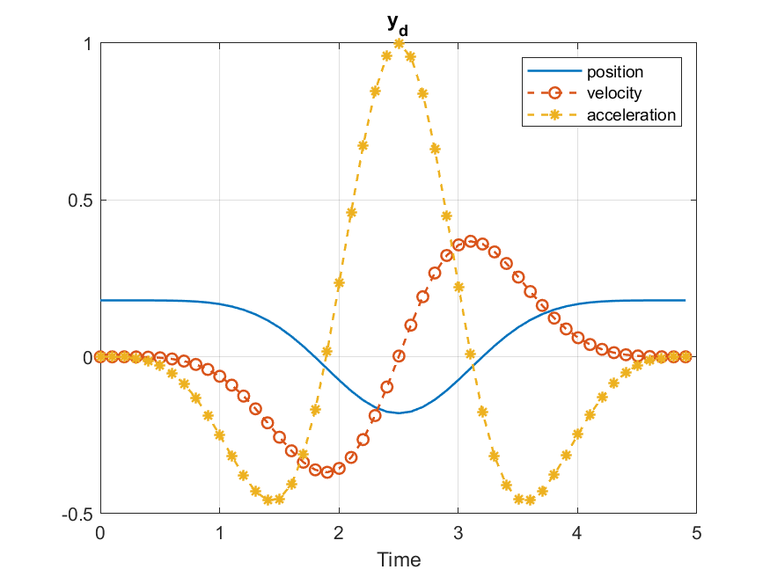
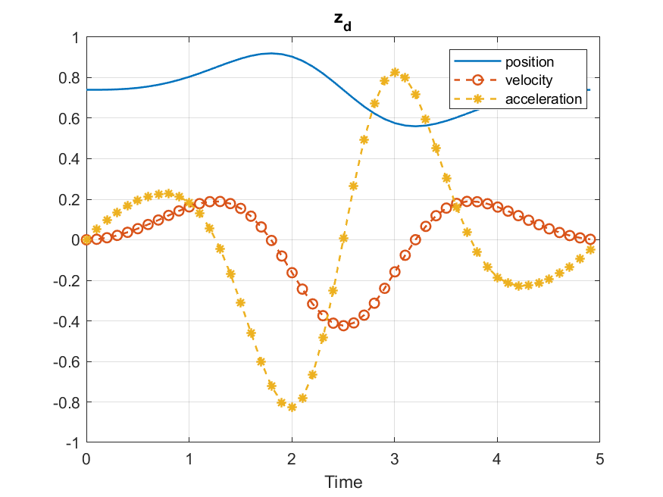
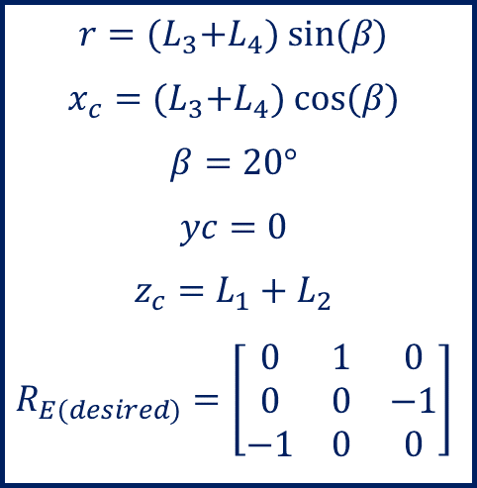
Trajectory Planning
$$r={(L}_{3}+L_{4}) sin⁡(β)$$
$$x_{c}={(L}_{3}+L_{4}) cos⁡(β)$$
$$β=20°$$
$$yc=0$$
$$z_{c}=L_{1}+L_{2}$$
$$R_{E(desired)}=\left[\begin{matrix}0 & 1 & 0 \\ 0 & 0 & −1 \\ −1 & 0 & 0\end{matrix}\right]$$

Slide 6
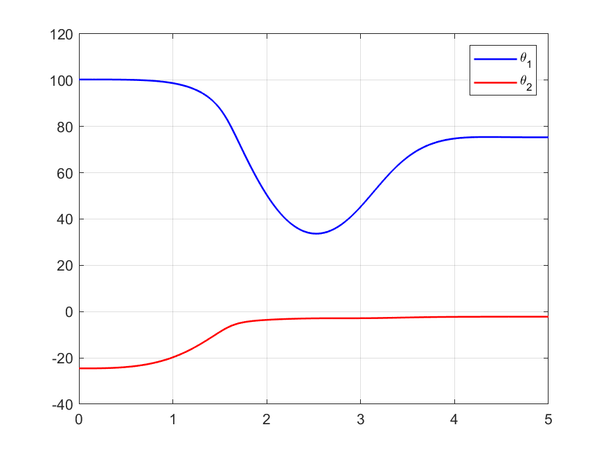
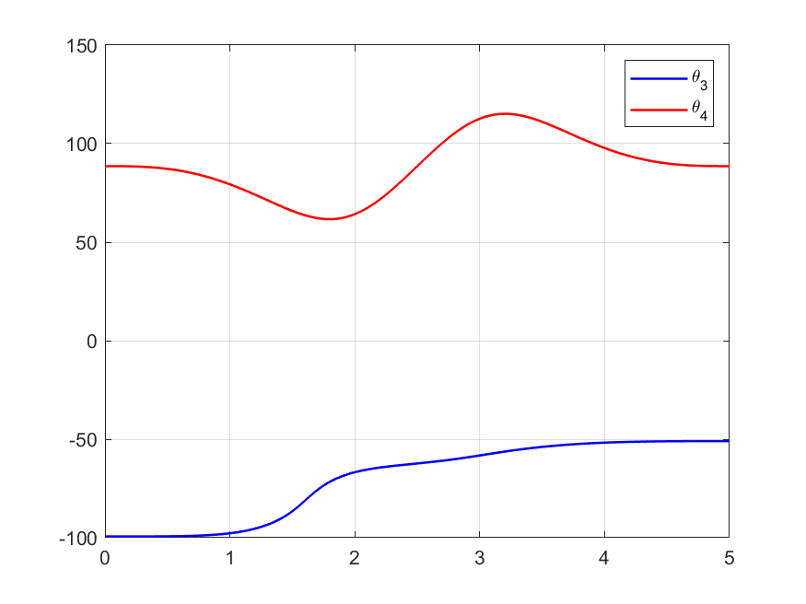
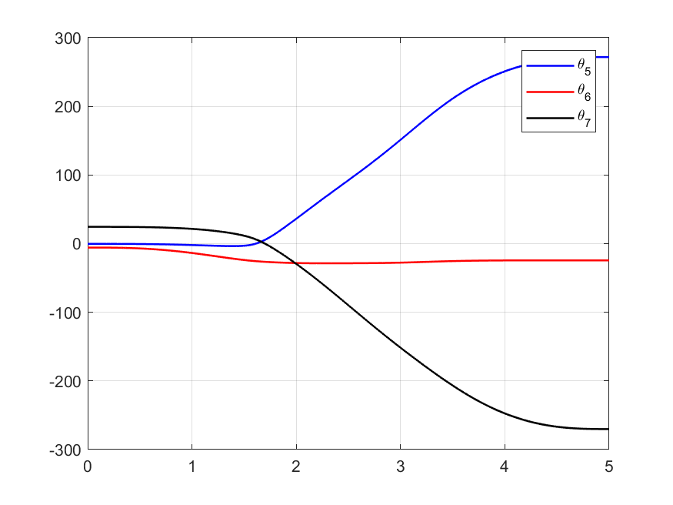
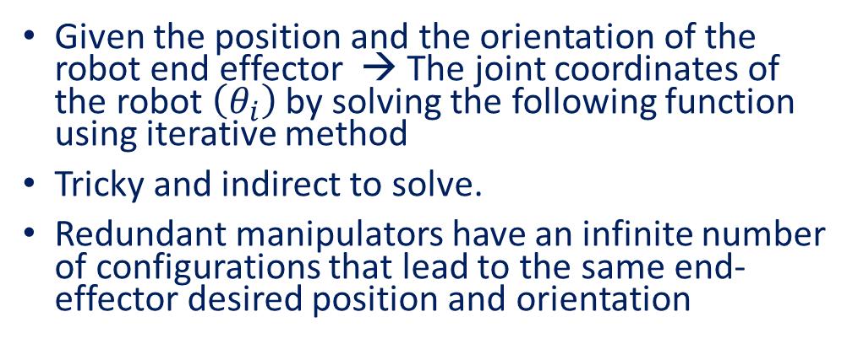
Inverse Kinematic
Given the position and the orientation of the robot end effector → The joint coordinates of the robot $\left(θ_{i}\right)$ by solving the following function using iterative method
Tricky and indirect to solve.
Redundant manipulators have an infinite number of configurations that lead to the same end-effector desired position and orientation
$$F=\left[\begin{matrix}Actual position −Desired postion \\ Actual orientation −Desired oreintation \end{matrix}\right]=0$$

Slide 7
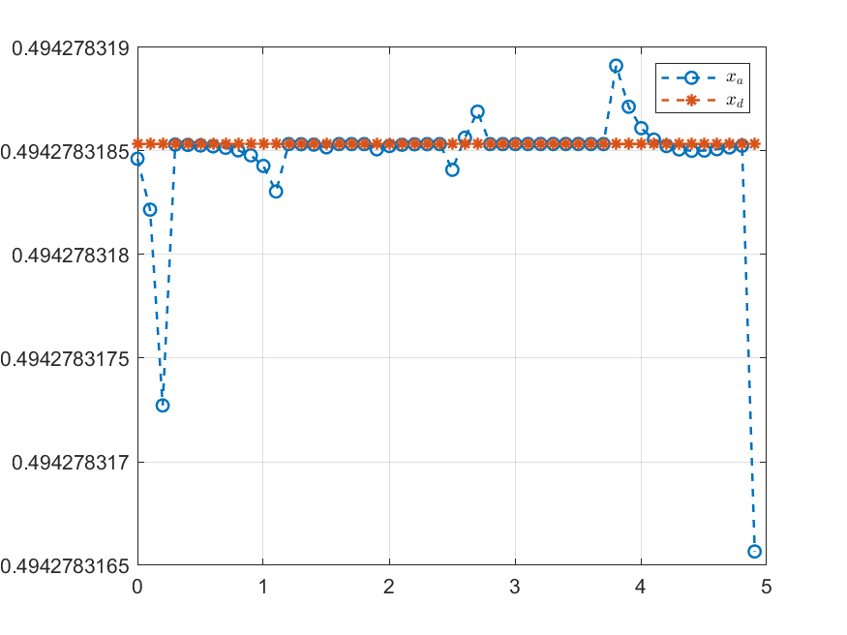
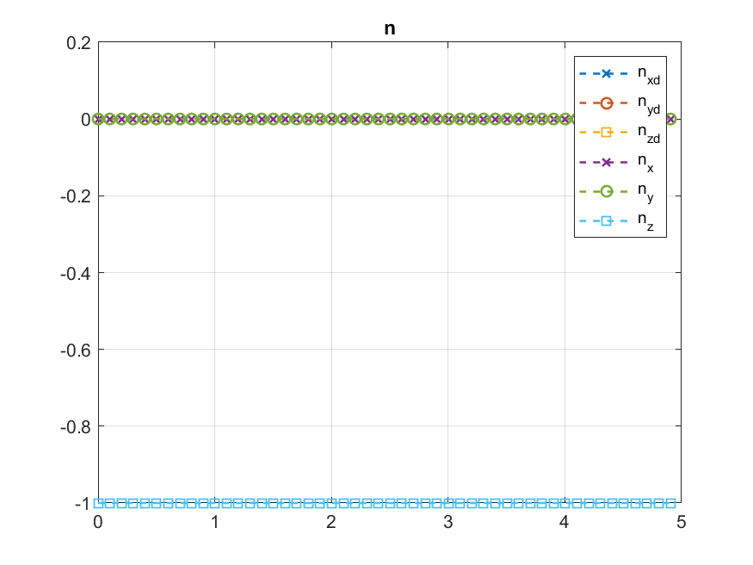
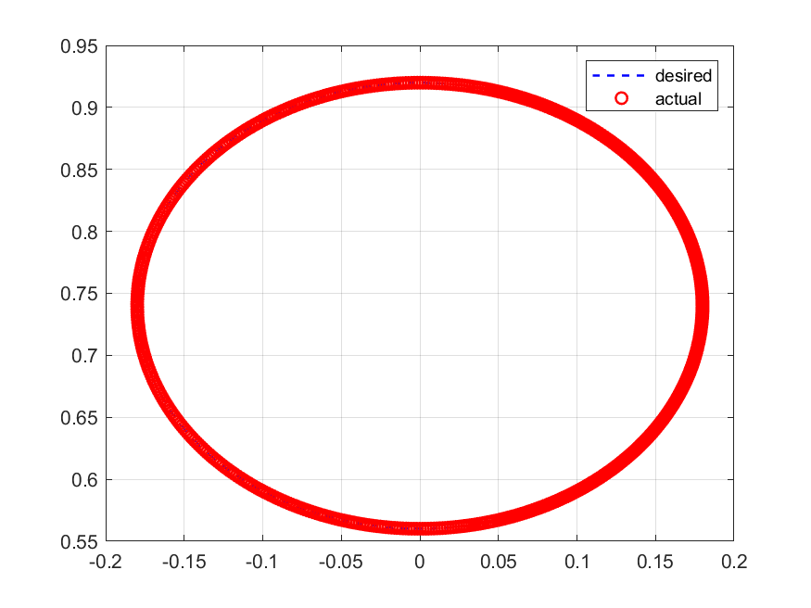
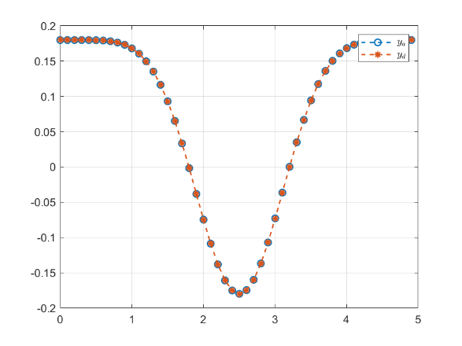
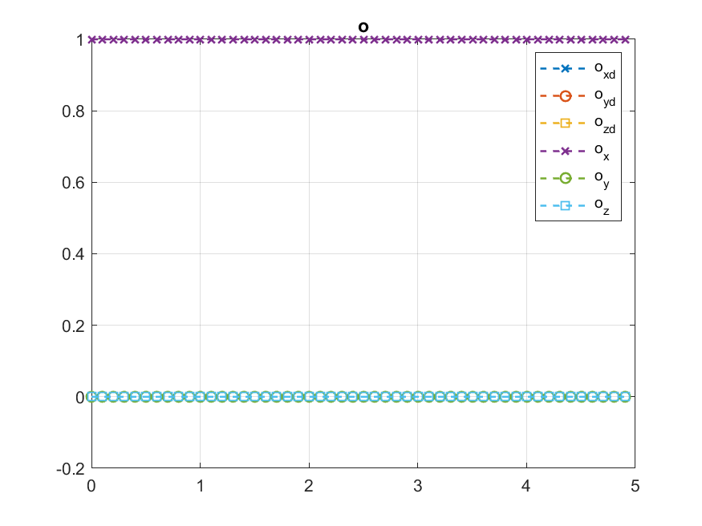
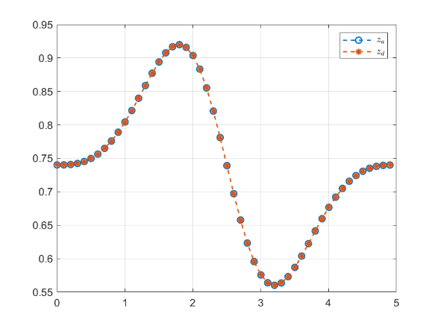
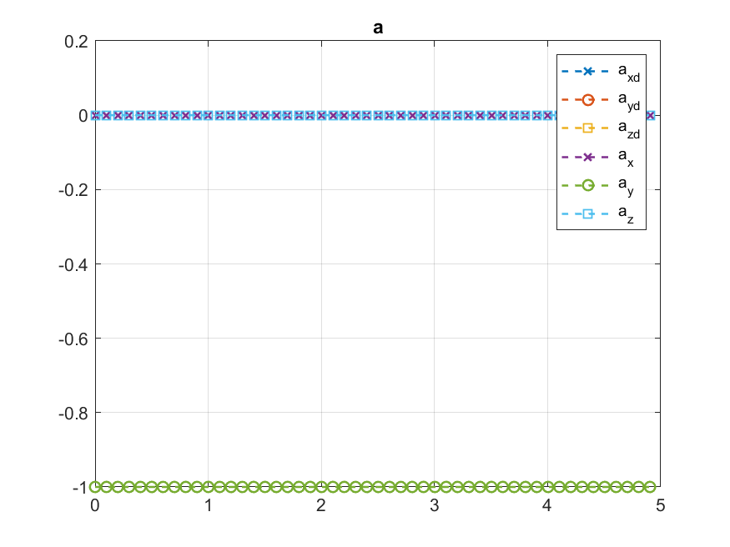

Slide 8
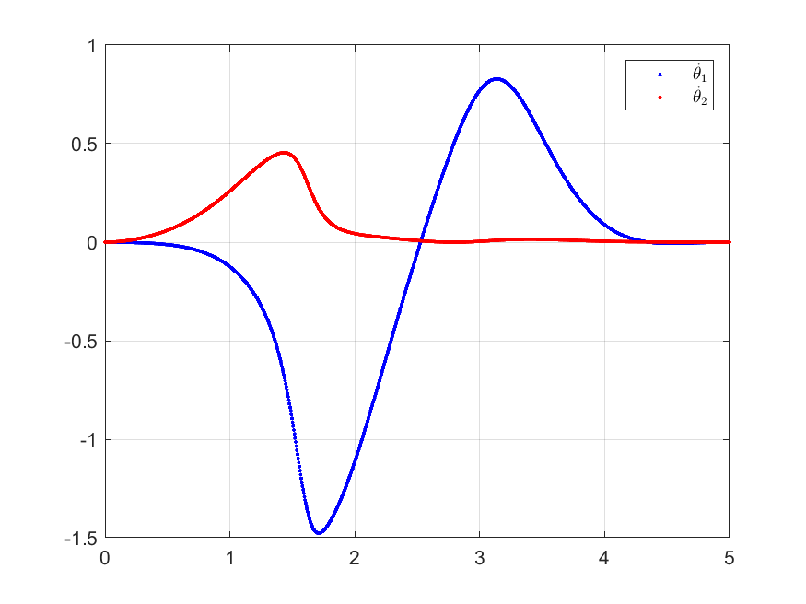
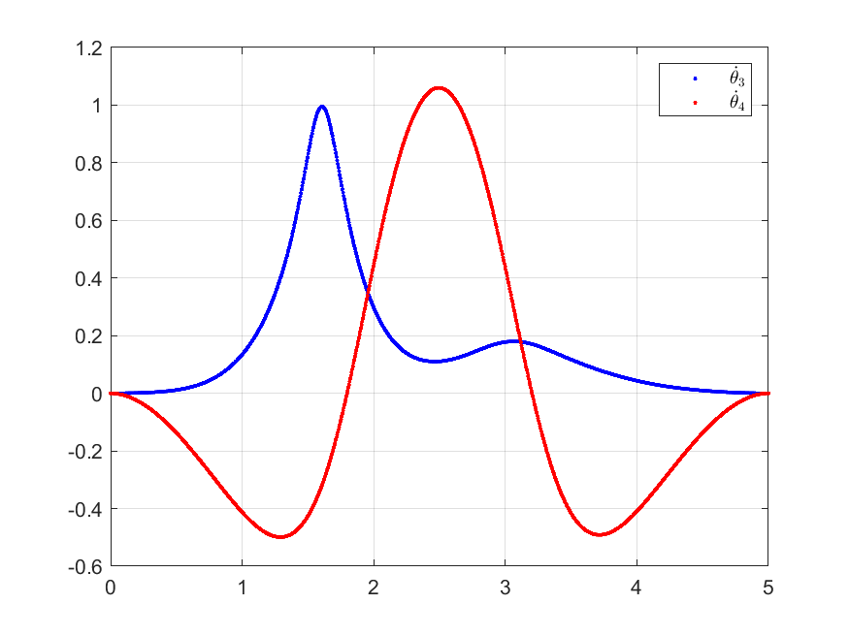
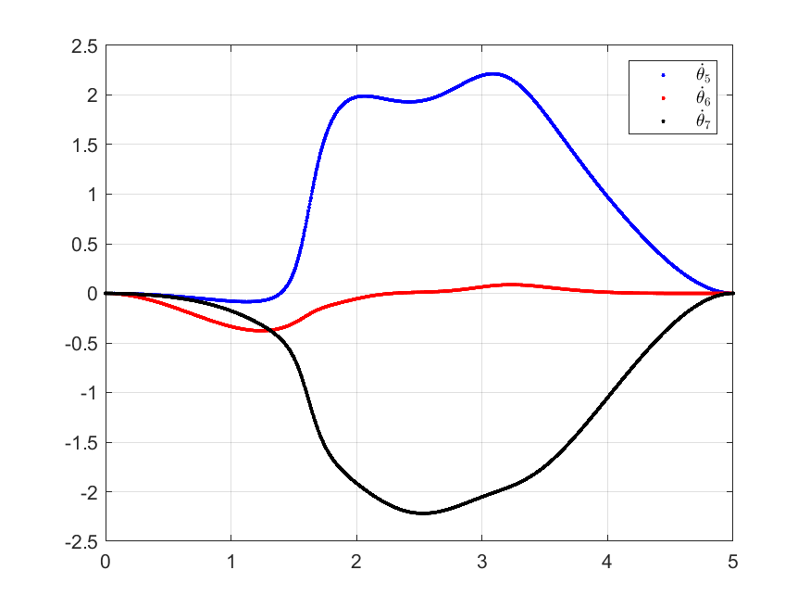
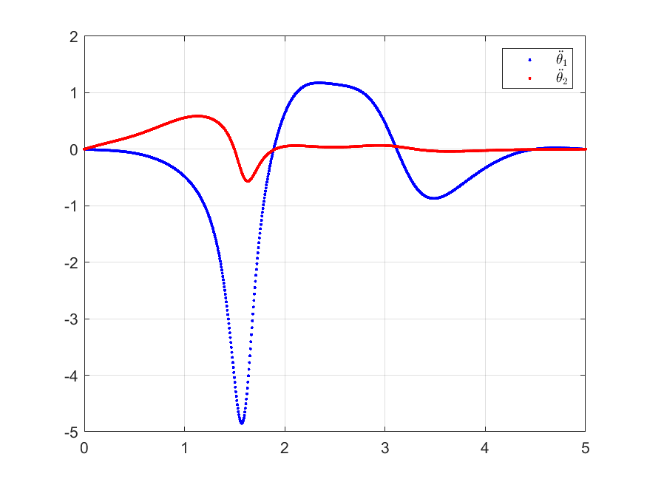
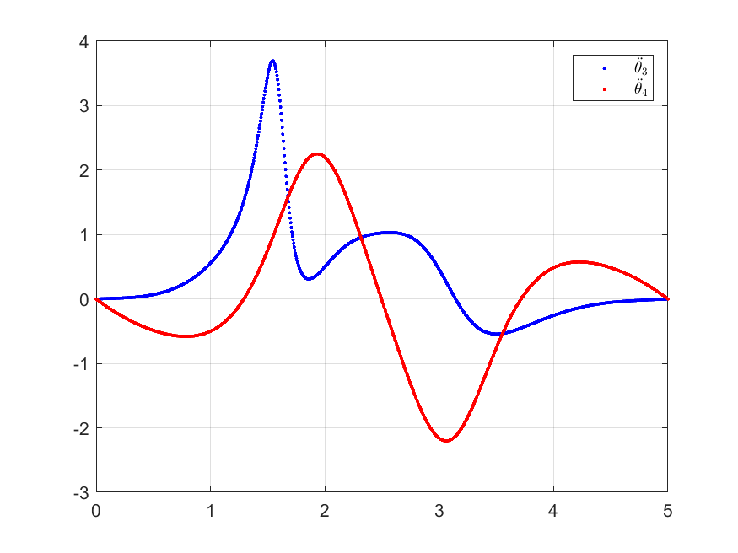
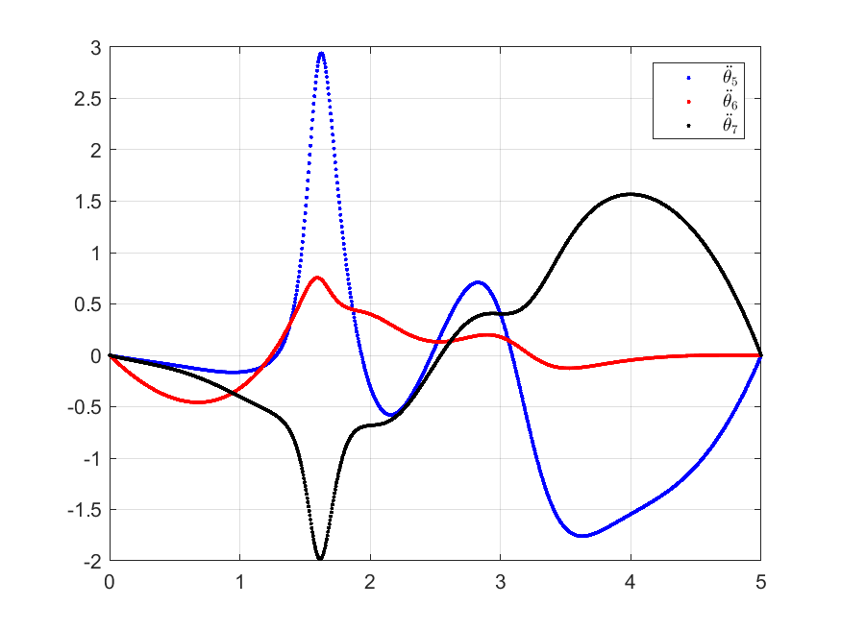
Inverse Velocity and Acceleration

Slide 9
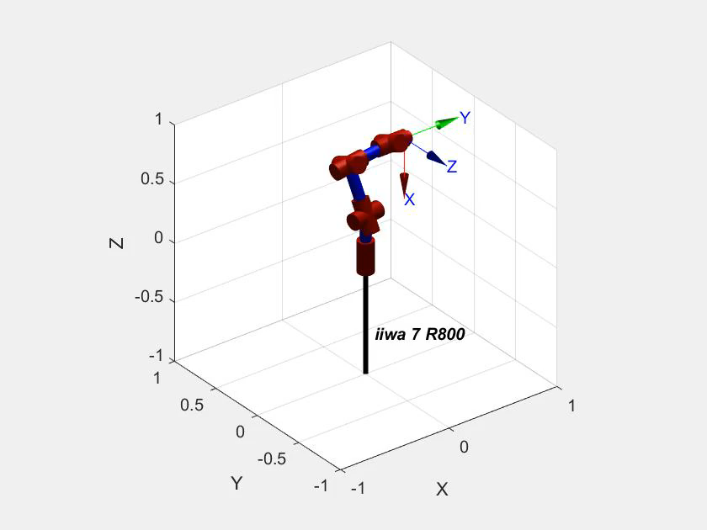
Simulation

Slide 10
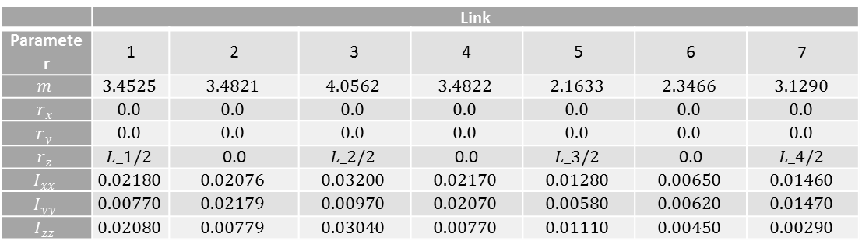
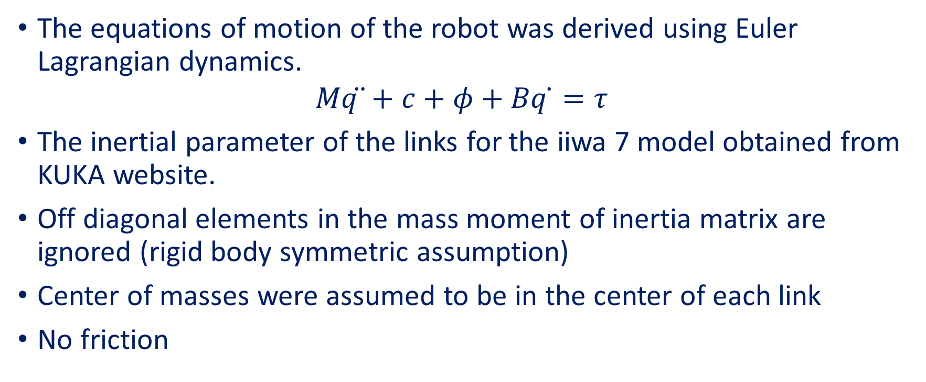
Dynamical Modeling
The equations of motion of the robot was derived using Euler Lagrangian dynamics.
$$Mq ̈+c+φ+Bq ̇=τ$$
The inertial parameter of the links for the iiwa 7 model obtained from KUKA website.
Off diagonal elements in the mass moment of inertia matrix are ignored (rigid body symmetric assumption)
Center of masses were assumed to be in the center of each link
No friction
 | Link
Parameter | 1 | 2 | 3 | 4 | 5 | 6 | 7
$$m$$ | $$3.4525$$ | $$3.4821$$ | $$4.0562$$ | $$3.4822$$ | $$2.1633$$ | $$2.3466$$ | $$3.1290$$
$$r_{x}$$ | $$0.0$$ | $$0.0$$ | $$0.0$$ | $$0.0$$ | $$0.0$$ | $$0.0$$ | $$0.0$$
$$r_{y}$$ | $$0.0$$ | $$0.0$$ | $$0.0$$ | $$0.0$$ | $$0.0$$ | $$0.0$$ | $$0.0$$
$$r_{z}$$ | $$L_1/2$$ | 0.0 | $$L_2/2$$ | 0.0 | $$L_3/2$$ | 0.0 | $$L_4/2$$
$$I_{xx}$$ | $$0.02180$$ | $$0.02076$$ | $$0.03200$$ | $$0.02170$$ | $$0.01280$$ | $$0.00650$$ | $$0.01460$$
$$I_{yy}$$ | $$0.00770$$ | $$0.02179$$ | $$0.00970$$ | $$0.02070$$ | $$0.00580$$ | $$0.00620$$ | $$0.01470$$
$$I_{zz}$$ | $$0.02080$$ | $$0.00779$$ | $$0.03040$$ | $$0.00770$$ | $$0.01110$$ | $$0.00450$$ | $$0.00290$$

Slide 11
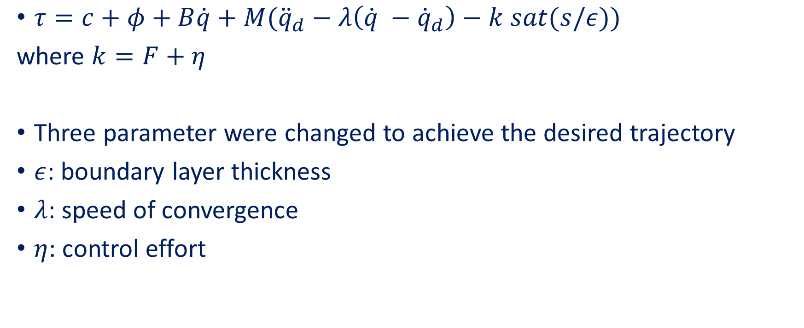
Sliding Control
$τ=c+φ+B\dot{q}+M({\ddot{q}}_{d}−λ\left(\dot{q} −{\dot{q}}_{d}\right)−k sat(s/ε))$
where $k=F+η$
Three parameter were changed to achieve the desired trajectory
$ε$: boundary layer thickness
$λ$: speed of convergence
$η$: control effort

Slide 12

Case 1
$$ε=0.01 λ=1.5 η=4$$

Slide 13
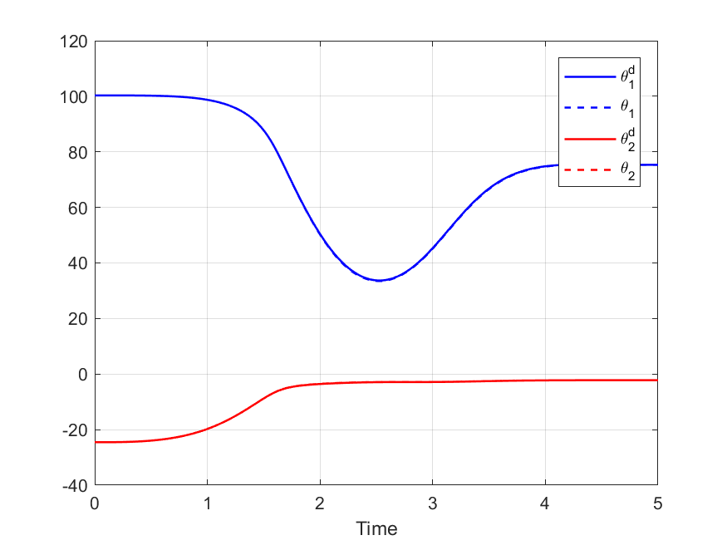
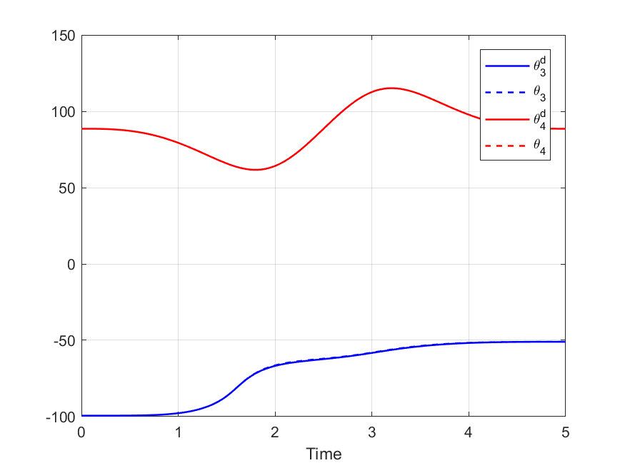
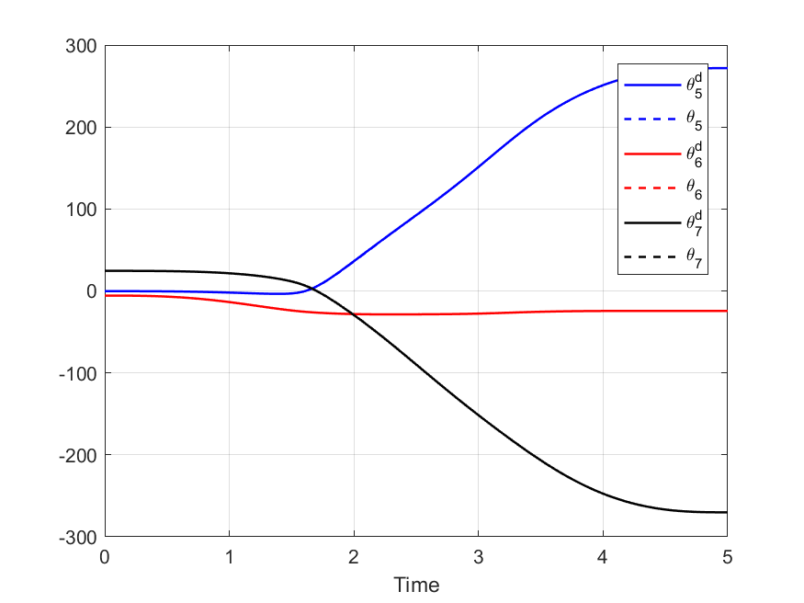
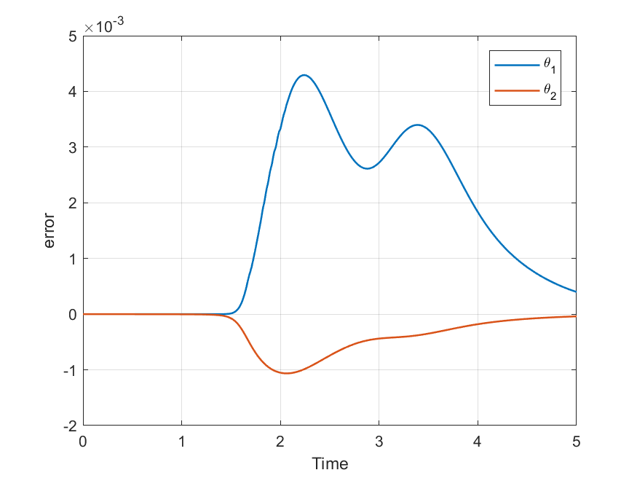
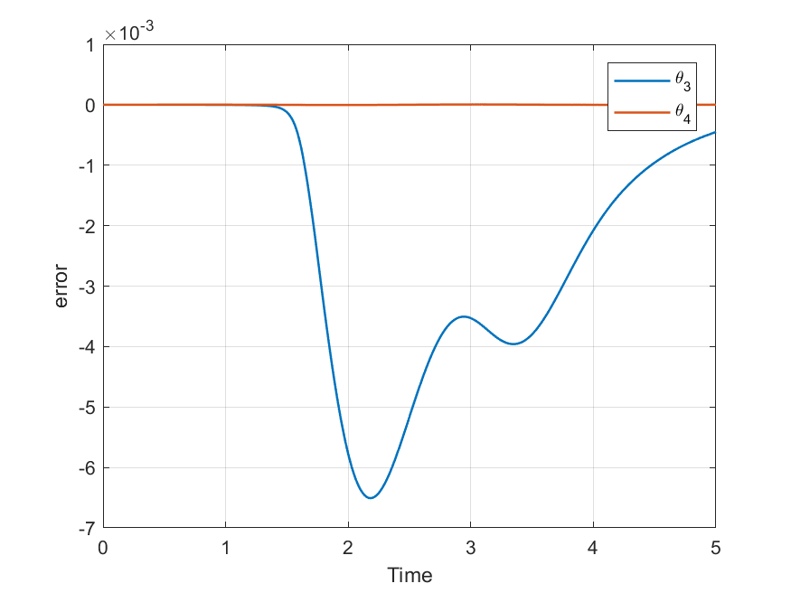
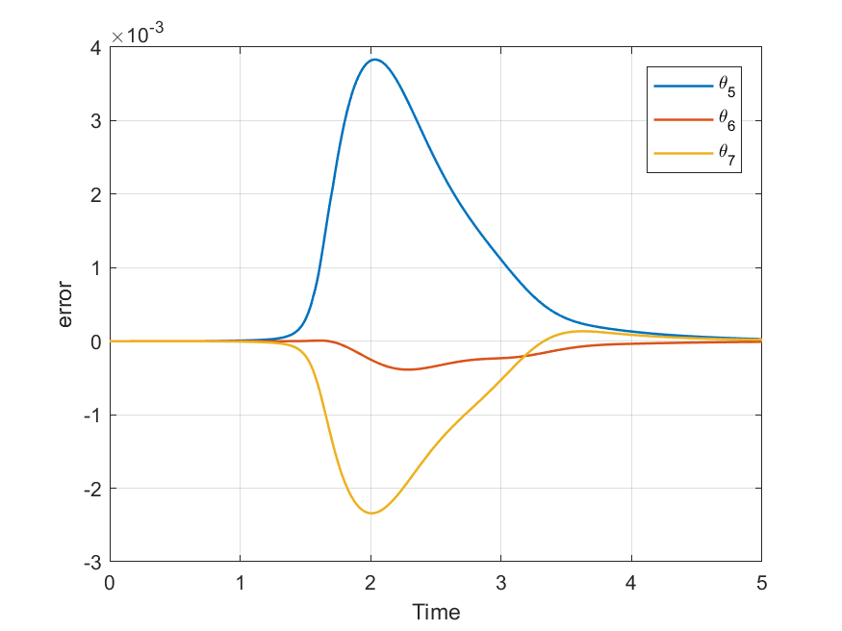
Joint variables (Actual vs Desired)

Slide 14
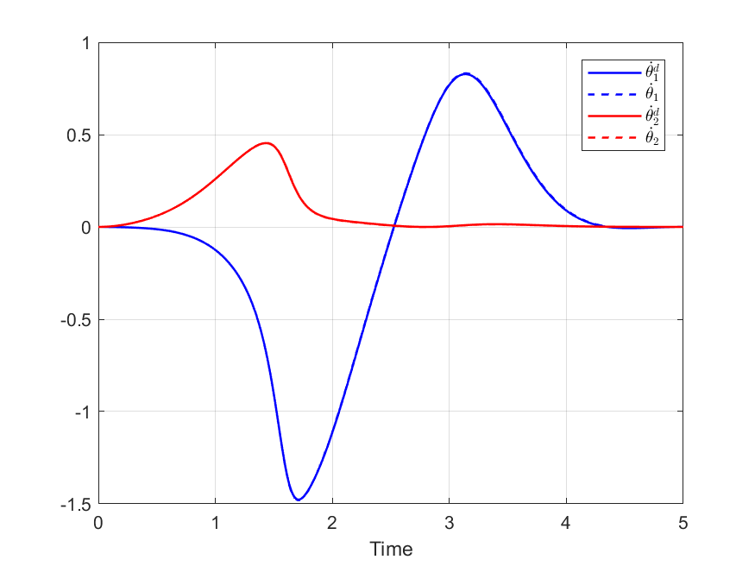
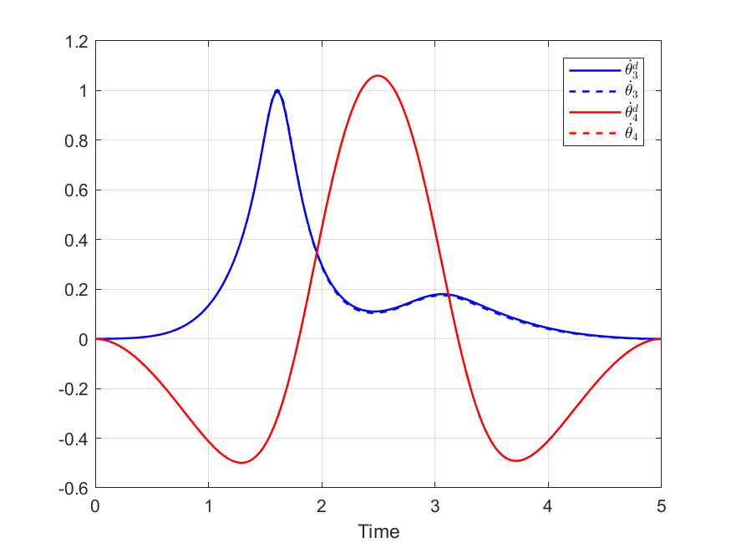
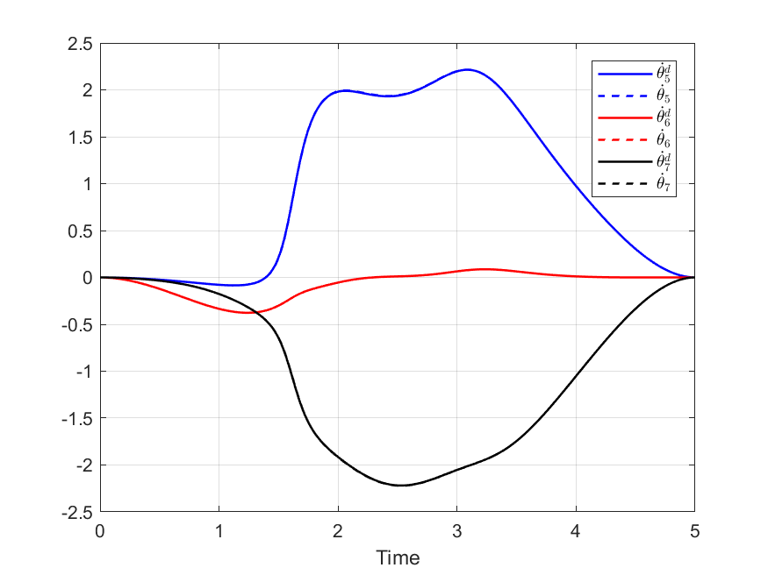
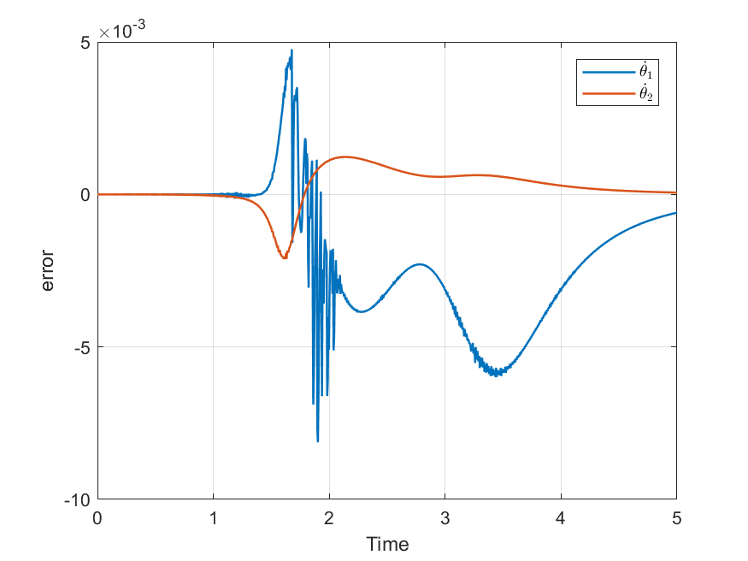
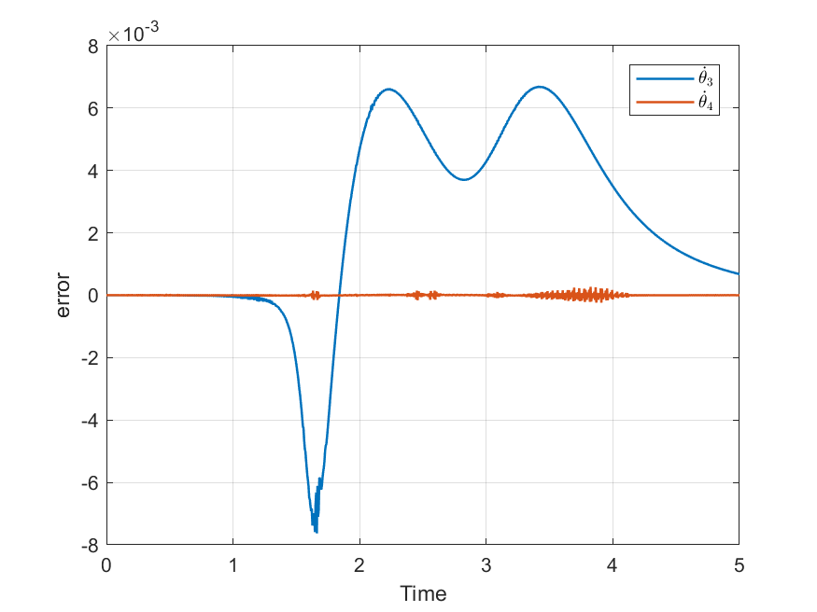
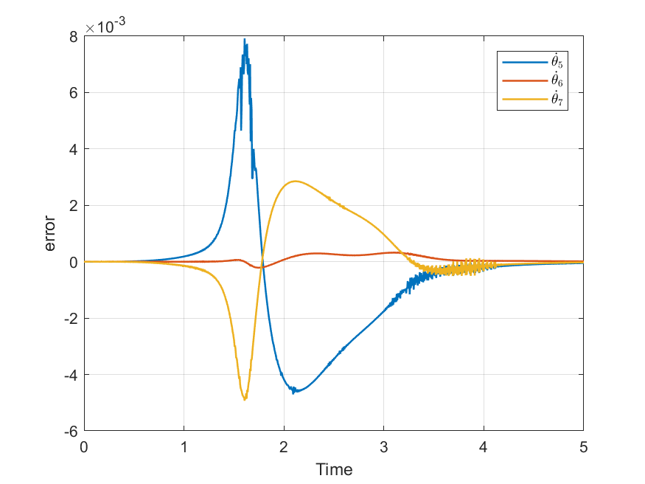

Slide 15
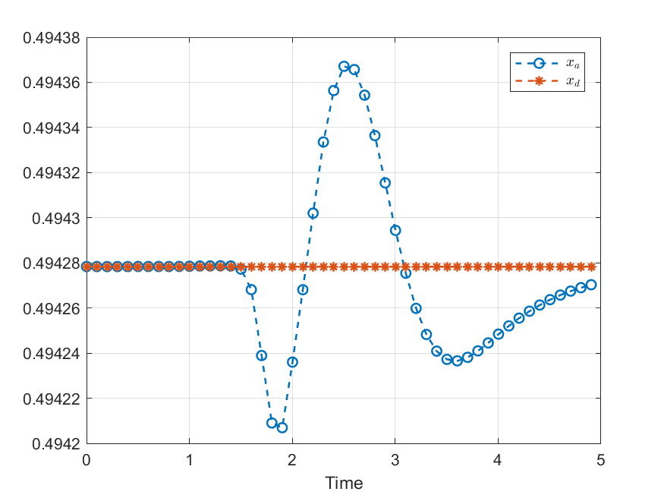
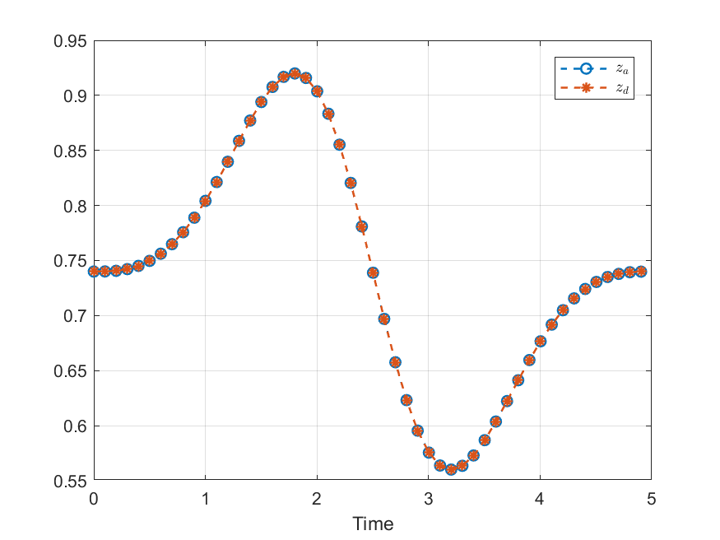
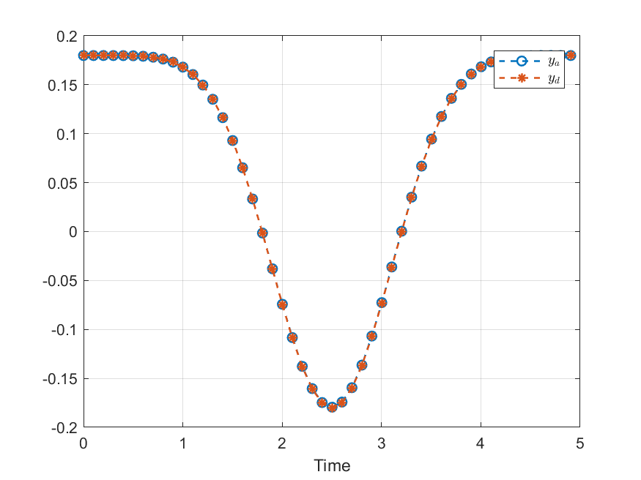
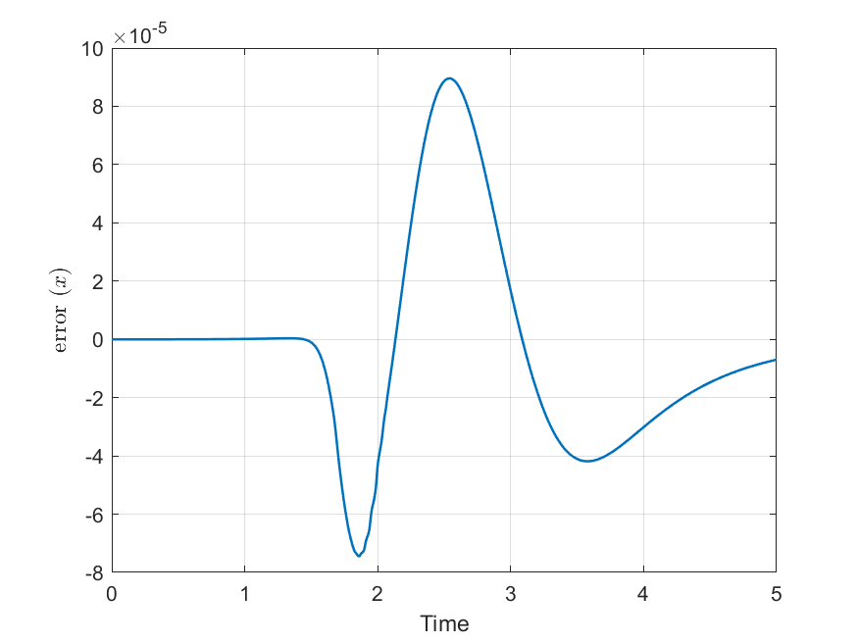
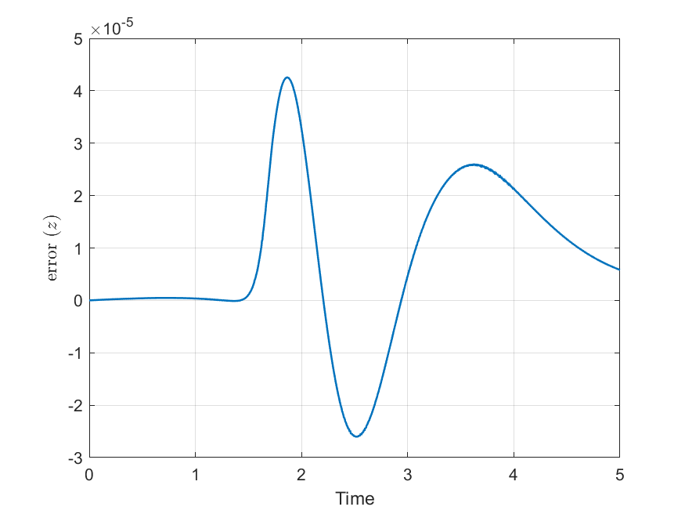

Trajectory (Actual vs Desired)

Slide 16







Slide 17


Slide 18







Input

Slide 19

Case 2
$$ε=0.3 λ=1.5 η=4$$

Slide 20






(Actual vs Desired)

Slide 21







Input

Slide 22

Case 3
$$ε=2 λ=1.5 η=4$$

Slide 23






(Actual vs Desired)

Slide 24







Input

Slide 25
Lessons learned
Inverse kinematic for a redundant robot is hard to solve → start from a known solution
Singularity in Jacobian matrix for some desired trajectory
Complex EOM → takes loooong time → parallel computation
Sliding control chattering / trade off

Slide 26
Thank You!

